Slide 1
Efficiency in Machine Learning via Tensor Decomposition Range Queries and More
Ruizhong Qiu
University of Illinois Urbana-Champaign

Slide 2
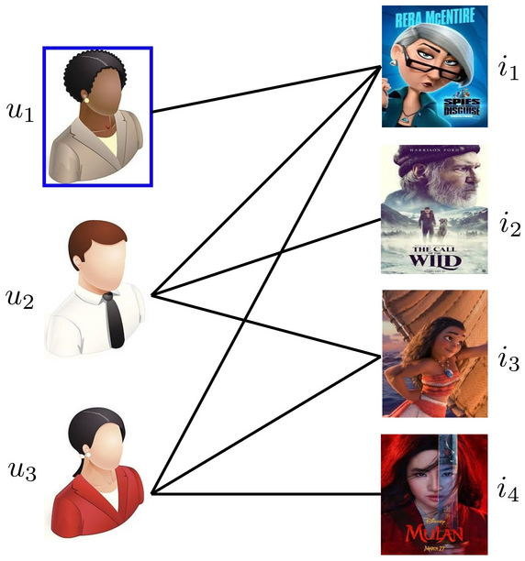
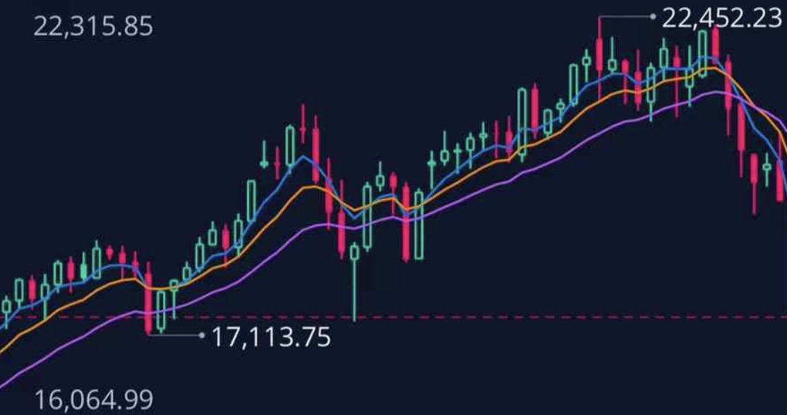
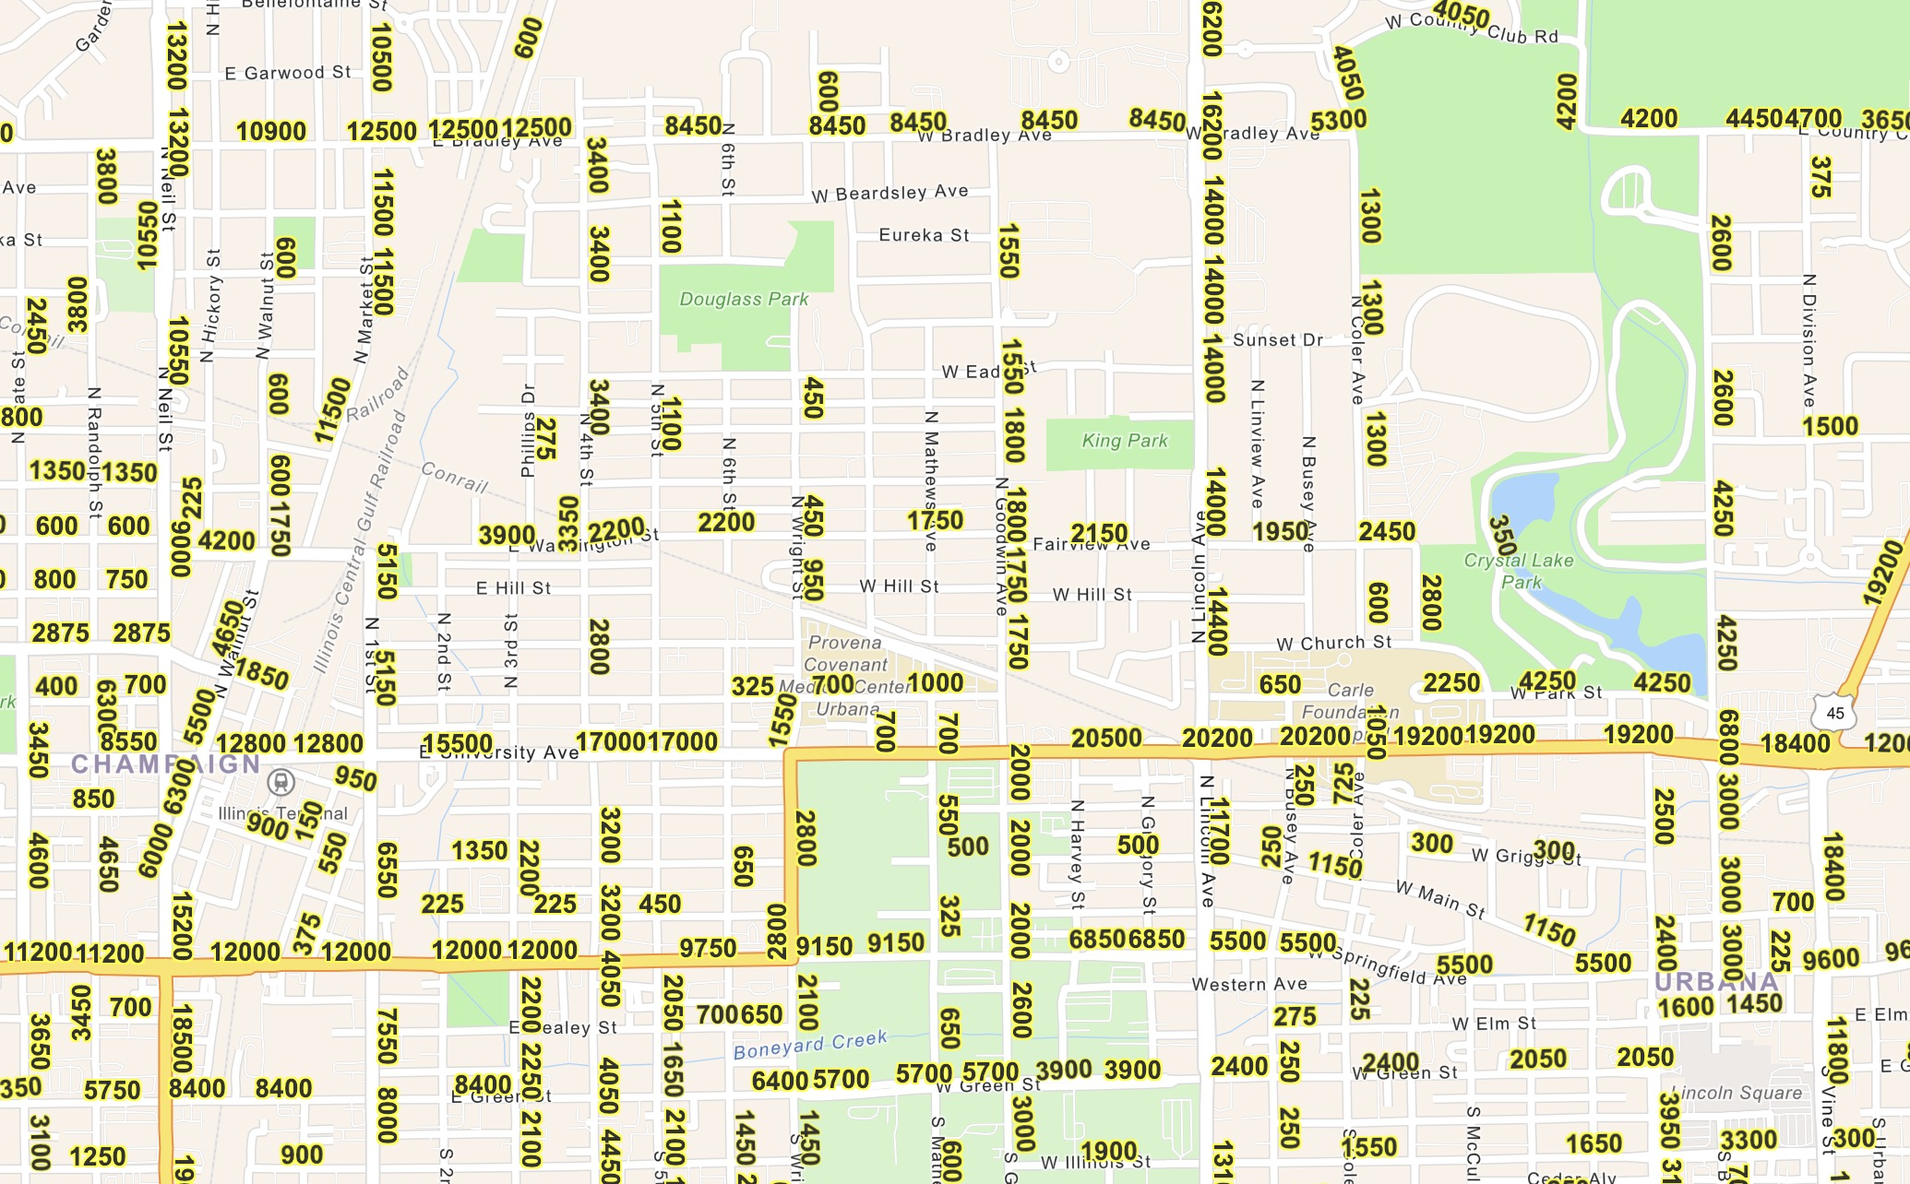
Range Queries over Tensor Streams
Social Media: Interaction History
Finance: Stock Prices
Transportation: Traffic Volumes
Environmentology: Air Quality

Slide 3
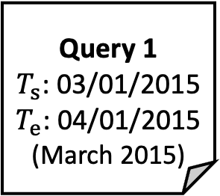

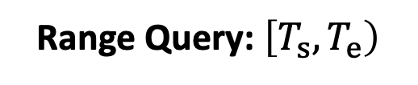


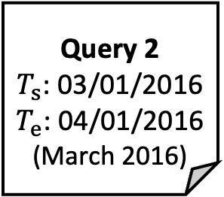

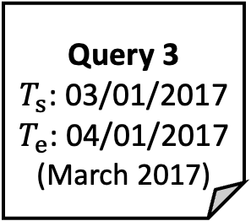
Range Queries over Tensor Streams
Example: Comparing the air quality of Korea [1] in March 2015, 2016, & 2017.
Tensor Time Series: Air Quality $𝒳_{t,i,j}$
Range Query: $\left[T_{s},T_{e}\right)$
01/01/2015
Time $t$
05/24/2017
Query 1
$T_{s}$: 03/01/2015
$T_{e}$: 04/01/2015
(March 2015)
Query 2
$T_{s}$: 03/01/2016
$T_{e}$: 04/01/2016
(March 2016)
Query 3
$T_{s}$: 03/01/2017
$T_{e}$: 04/01/2017
(March 2017)
Pollutant $j$
Location $i$
[1] Air Korea. https://www.airkorea.or.kr/web/

Slide 4
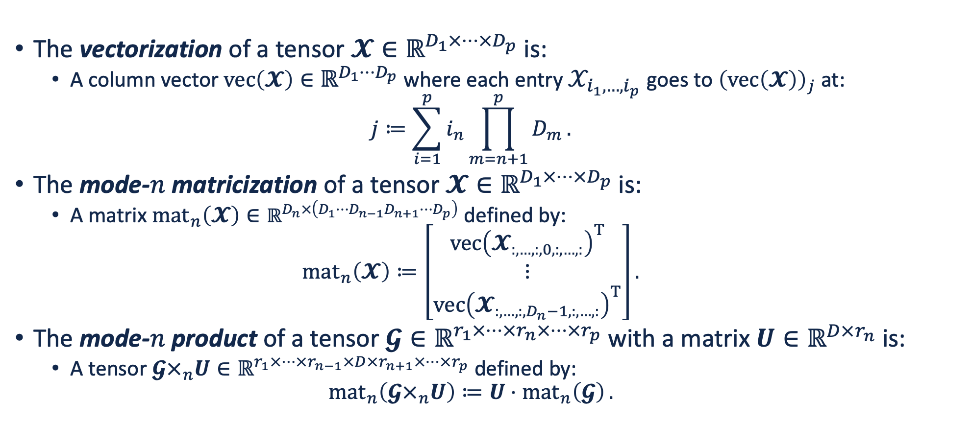
Preliminaries: Tensor Operations [1]
The vectorization of a tensor $𝓧∈ℝ^{D_{1}×⋯×D_{p}}$ is:
A column vector $\operatorname{vec}\left(𝓧\right)∈ℝ^{D_{1}⋯D_{p}}$ where each entry $𝒳_{i_{1},…,i_{p}}$ goes to ${\left(\operatorname{vec}\left(𝓧\right)\right)}_{j}$ at:
$$j≔\sum_{i=1}^{p}{i_{n}\prod_{m=n+1}^{p}{D_{m}}}.$$
The mode-$n$ matricization of a tensor $𝓧∈ℝ^{D_{1}×⋯×D_{p}}$ is:
A matrix ${mat}_{n}\left(𝓧\right)∈ℝ^{D_{n}×\left(D_{1}⋯D_{n−1}D_{n+1}⋯D_{p}\right)}$ defined by:
$${mat}_{n}\left(𝓧\right)≔\left[\begin{aligned}{\operatorname{vec}\left(𝓧_{:,…,:,0,:,…,:}\right)}^{T} \\ ⋮ \\ {\operatorname{vec}\left(𝓧_{:,…,:,D_{n}−1,:,…,:}\right)}^{T}\end{aligned}\right].$$
The mode-$n$ product of a tensor $𝓖∈ℝ^{r_{1}×⋯×r_{n}×⋯×r_{p}}$ with a matrix $U∈ℝ^{D×r_{n}}$ is:
A tensor $𝓖×_{n}U∈ℝ^{r_{1}×⋯×r_{n−1}×D×r_{n+1}×⋯×r_{p}}$ defined by:
$${mat}_{n}\left(𝓖×_{n}U\right)≔U⋅{mat}_{n}\left(𝓖\right).$$
[1] Kolda & Bader. Tensor decompositions and applications. SIAM Review 51(3): 455–500, 2009.

Slide 5
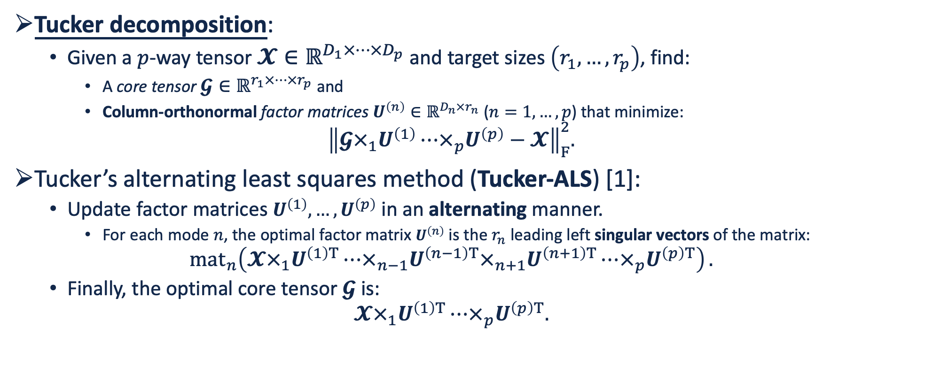
Preliminaries: Tucker Decomposition
Tucker decomposition:
Given a $p$-way tensor $𝓧∈ℝ^{D_{1}×⋯×D_{p}}$ and target sizes $\left(r_{1},…,r_{p}\right)$, find:
A core tensor $𝓖∈ℝ^{r_{1}×⋯×r_{p}}$ and
Column-orthonormal factor matrices $U^{\left(n\right)}∈ℝ^{D_{n}×r_{n}}$ ($n=1,…,p$) that minimize:
$${\left\|𝓖×_{1}U^{\left(1\right)}⋯×_{p}U^{\left(p\right)}−𝓧\right\|}_{F}^{2}.$$
Tucker’s alternating least squares method (Tucker-ALS) [1]:
Update factor matrices $U^{\left(1\right)},…,U^{\left(p\right)}$ in an alternating manner.
For each mode $n$, the optimal factor matrix $U^{\left(n\right)}$ is the $r_{n}$ leading left singular vectors of the matrix:
$${mat}_{n}\left(𝓧×_{1}U^{\left(1\right)T}⋯×_{n−1}U^{\left(n−1\right)T}×_{n+1}U^{\left(n+1\right)T}⋯×_{p}U^{\left(p\right)T}\right).$$
Finally, the optimal core tensor $𝓖$ is:
$$𝓧×_{1}U^{\left(1\right)T}⋯×_{p}U^{\left(p\right)T}.$$
[1] Tucker. Some mathematical notes on three-mode factor analysis. Psychometrika 31(3): 279–311, 1966.

Slide 6

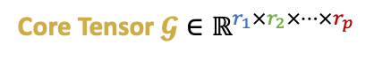

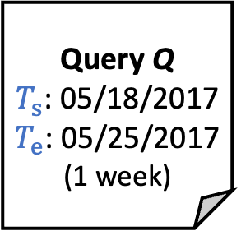
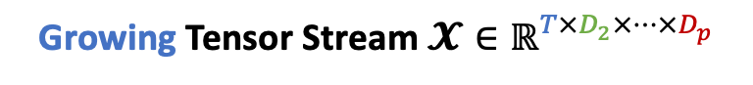

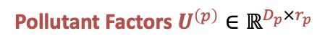


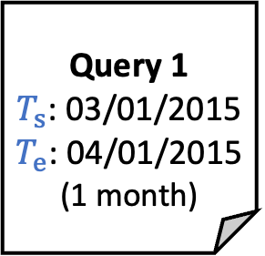
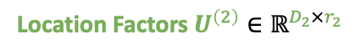
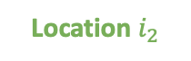
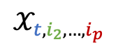

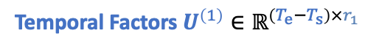
Problem Definition
Growing Tensor Stream $𝓧∈ℝ^{T×D_{2}×⋯×D_{p}}$
Range Query $\left[T_{s},T_{e}\right)⊆\left[0,T\right)$
01/01/2015
Time $t$
05/24/2017
Pollutant $i_{p}$
Query 1
$T_{s}$: 03/01/2015
$T_{e}$: 04/01/2015
(1 month)
Query Q
$T_{s}$: 05/18/2017
$T_{e}$: 05/25/2017
(1 week)
$$𝒳_{t,i_{2},…,i_{p}}$$
$$⋯$$
Location $i_{2}$
Query 1
Query Q
Target Tucker Sizes $\left(r_{1},r_{2},…,r_{p}\right)$
Tucker-ALS
Pollutant Factors $U^{\left(p\right)}∈ℝ^{D_{p}×r_{p}}$
Temporal Factors $U^{\left(1\right)}∈ℝ^{\left(T_{e}−T_{s}\right)×r_{1}}$
$$⋯$$
Core Tensor $𝓖∈ℝ^{r_{1}×r_{2}×⋯×r_{p}}$
Location Factors $U^{\left(2\right)}∈ℝ^{D_{2}×r_{2}}$
TUCKET (ours)
Tucker Decomposition $𝓧_{\left[T_{s},T_{e}\right)}≈𝓖 ×_{1}U^{\left(1\right)}×_{2}U^{\left(2\right)}⋯×_{p}U^{\left(p\right)}$
Data Structure
Range Query Answering

Slide 7
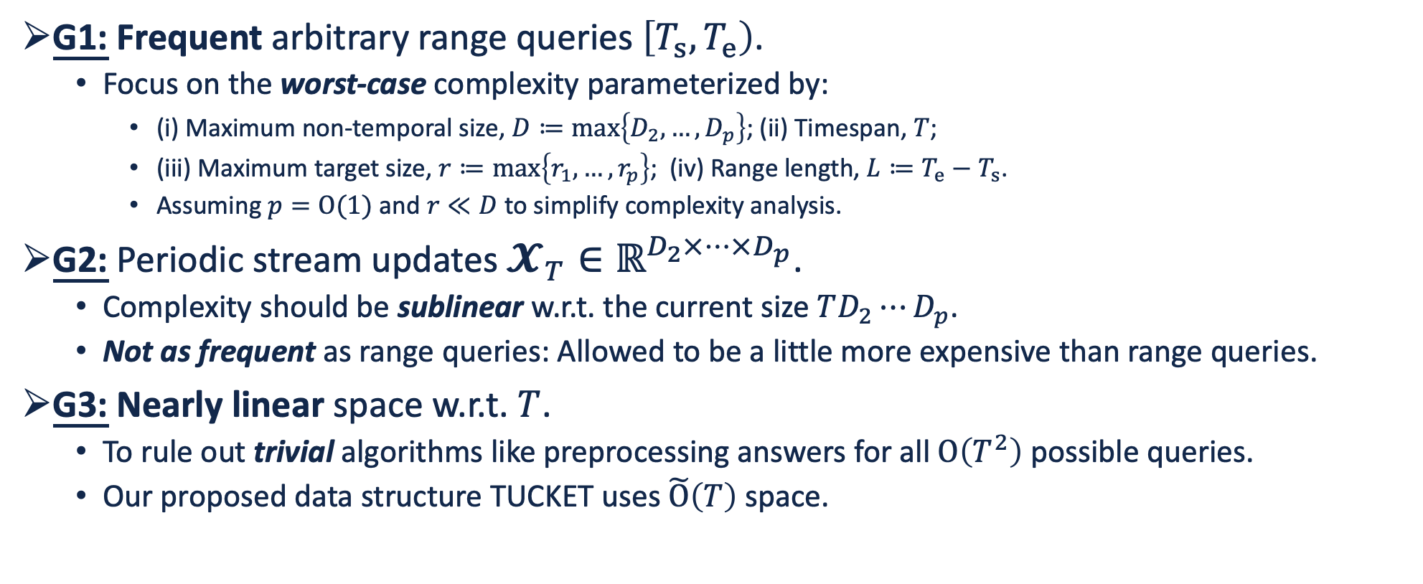
Design Goals
G1: Frequent arbitrary range queries $\left[T_{s},T_{e}\right)$.
Focus on the worst-case complexity parameterized by:
(i) Maximum non-temporal size, $D≔\max\left\{D_{2},…,D_{p}\right\}$; (ii) Timespan, $T$;
(iii) Maximum target size, $r≔\max\left\{r_{1}, …,r_{p}\right\}$; (iv) Range length, $L≔T_{e}−T_{s}$.
Assuming $p=O(1)$ and $r≪D$ to simplify complexity analysis.
G2: Periodic stream updates $𝓧_{T}∈ℝ^{D_{2}×⋯×D_{p}}$.
Complexity should be sublinear w.r.t. the current size $TD_{2}⋯D_{p}$.
Not as frequent as range queries: Allowed to be a little more expensive than range queries.
G3: Nearly linear space w.r.t. $T$.
To rule out trivial algorithms like preprocessing answers for all $O\left(T^{2}\right)$ possible queries.
Our proposed data structure TUCKET uses $\tilde{O}\left(T\right)$ space.

Slide 8
Contents
Introduction
Proposed Data Structure: TUCKET
Core Algorithms & Operations
Experimental Evaluation
Conclusion

Slide 9


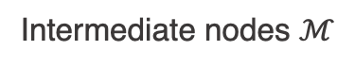

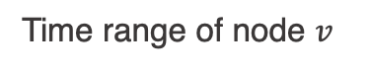
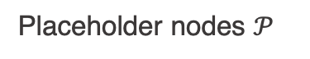
Proposed Stream Segment Tree (SST)
〈16〉
The original segment tree [1] has a static structure.
We propose stream segment trees to support stream updates (i.e., appending new slices).
[0, 16)
〈8〉
〈17〉
[0, 8)
[8, 16)
〈4〉
〈9〉
〈18〉
[0, 4)
[4, 8)
[8, 12)
〈$v$〉
Node number
$$\left[σ_{v},τ_{v}\right)$$
Time range of node $v$
〈2〉
〈5〉
〈10〉
〈13〉
〈19〉
Placeholder nodes $𝒫$
[0, 2)
[2, 4)
[4, 6)
[6, 8)
[8, 10)
Intermediate nodes $ℳ$
Leaf nodes $ℒ$
〈1〉
〈3〉
〈6〉
〈7〉
〈11〉
〈12〉
〈14〉
〈15〉
〈20〉
[0, 1)
[1, 2)
[2, 3)
[3, 4)
[4, 5)
[5, 6)
[6, 7)
[7, 8)
[8, 9)
[1] Bentley. Algorithms for Klee’s rectangle problems. 1977.

Slide 10
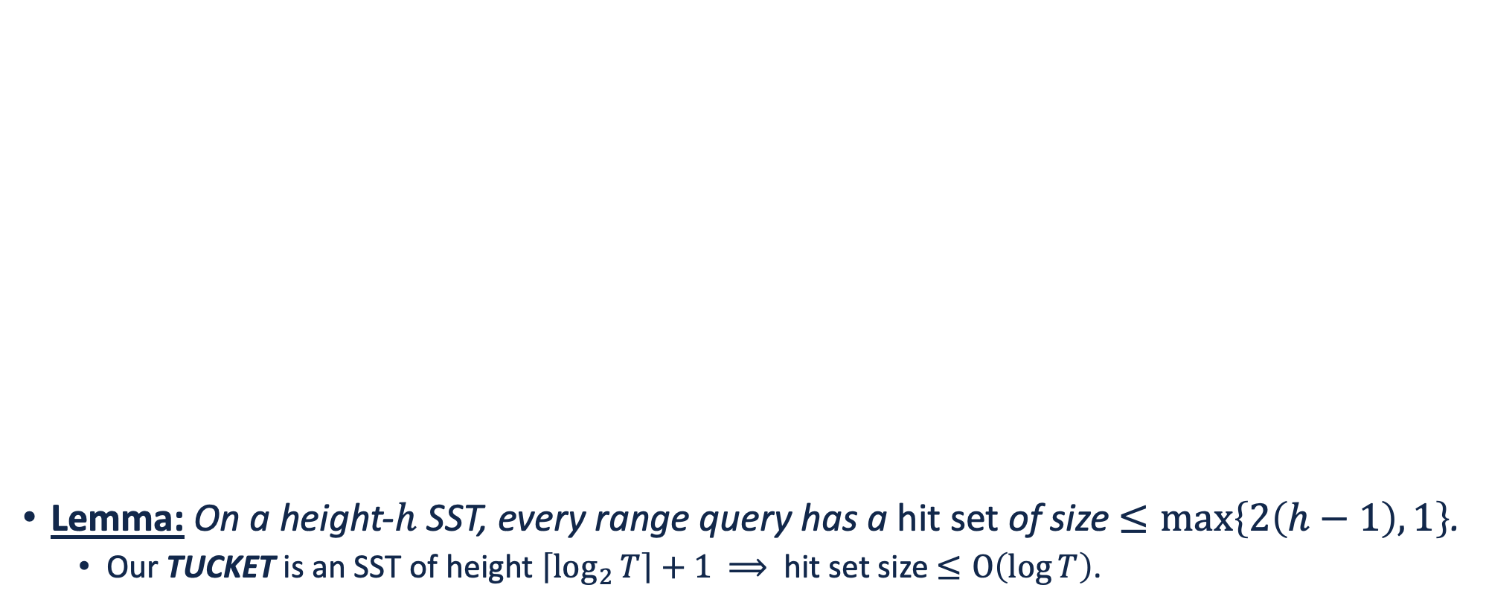
Hit Set of a Range Query
〈16〉
Lemma: On a height-$h$ SST, every range query has a hit set of size $≤\max\left\{2\left(h−1\right),1\right\}$.
Our TUCKET is an SST of height $\left\lceil \log_{2}{T}\right\rceil +1$ $⟹$ hit set size $≤O\left(\log{T}\right)$.
[0, 16)
〈8〉
〈17〉
[0, 8)
[8, 16)
〈4〉
〈9〉
〈18〉
[0, 4)
[4, 8)
[8, 12)
〈$v$〉
Node number
$$\left[σ_{v},τ_{v}\right)$$
Time range of node $v$
〈2〉
〈5〉
〈10〉
〈13〉
〈19〉
Placeholder nodes $𝒫$
[0, 2)
[2, 4)
[4, 6)
[6, 8)
[8, 10)
Intermediate nodes $ℳ$
Leaf nodes $ℒ$
〈1〉
〈3〉
〈6〉
〈7〉
〈11〉
〈12〉
〈14〉
〈15〉
〈20〉
[0, 1)
[1, 2)
[2, 3)
[3, 4)
[4, 5)
[5, 6)
[6, 7)
[7, 8)
[8, 9)
Hit set of [1, 6)

Slide 11
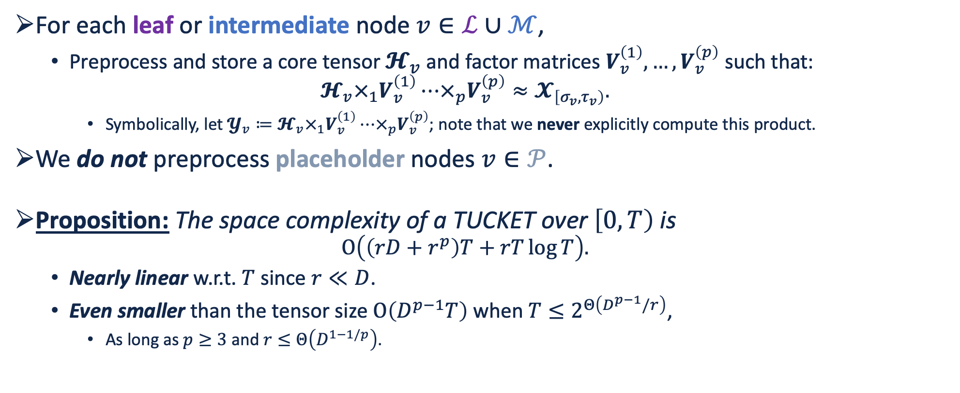
Preprocessing
For each leaf or intermediate node $v∈ℒ∪ℳ$,
Preprocess and store a core tensor $𝓗_{v}$ and factor matrices $V_{v}^{\left(1\right)},…,V_{v}^{\left(p\right)}$ such that:
$$𝓗_{v}×_{1}V_{v}^{\left(1\right)}⋯×_{p}V_{v}^{\left(p\right)}≈𝓧_{\left[σ_{v},τ_{v}\right)}.$$
Symbolically, let $𝓨_{v}≔𝓗_{v}×_{1}V_{v}^{\left(1\right)}⋯×_{p}V_{v}^{\left(p\right)}$; note that we never explicitly compute this product.
We do not preprocess placeholder nodes $v∈𝒫$.
Proposition: The space complexity of a TUCKET over $\left[0,T\right)$ is
$$O\left(\left(rD+r^{p}\right)T+rT\log{T}\right).$$
Nearly linear w.r.t. $T$ since $r≪D$.
Even smaller than the tensor size $O\left(D^{p−1}T\right)$ when $T≤2^{Θ\left(D^{p−1}/r\right)}$,
As long as $p≥3$ and $r≤Θ\left(D^{1−1/p}\right)$.

Slide 12
Contents
Introduction
Proposed Data Structure: TUCKET
Core Algorithms & Operations
Experimental Evaluation
Conclusion

Slide 13
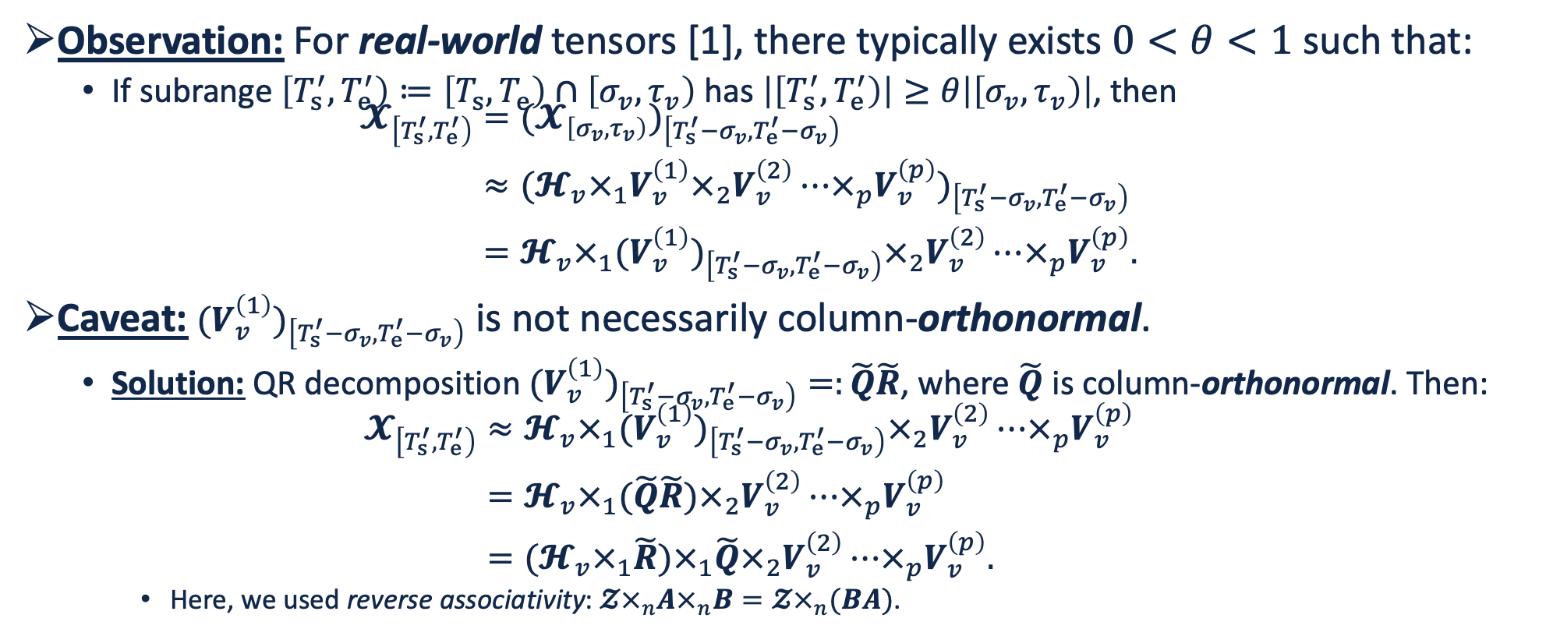
Approximating a Subtensor Decomposition
Observation: For real-world tensors [1], there typically exists $0<θ<1$ such that:
If subrange $\left[T_{s}^{′},T_{e}^{′}\right)≔\left[T_{s},T_{e}\right)∩\left[σ_{v},τ_{v}\right)$ has $\left|\left[T_{s}^{′},T_{e}^{′}\right)\right|≥θ\left|\left[σ_{v},τ_{v}\right)\right|$, then
$$\begin{aligned}𝓧_{\left[T_{s}^{′},T_{e}^{′}\right)}&=(𝓧_{\left[σ_{v},τ_{v}\right)})_{\left[T_{s}^{′}−σ_{v},T_{e}^{′}−σ_{v}\right)} \\ &≈(𝓗_{v}×_{1}V_{v}^{\left(1\right)}×_{2}V_{v}^{\left(2\right)}⋯×_{p}V_{v}^{\left(p\right)})_{\left[T_{s}^{′}−σ_{v},T_{e}^{′}−σ_{v}\right)} \\ &=𝓗_{v}×_{1}(V_{v}^{\left(1\right)})_{\left[T_{s}^{′}−σ_{v},T_{e}^{′}−σ_{v}\right)}×_{2}V_{v}^{\left(2\right)}⋯×_{p}V_{v}^{\left(p\right)}.\end{aligned}$$
Caveat: $(V_{v}^{\left(1\right)})_{\left[T_{s}^{′}−σ_{v},T_{e}^{′}−σ_{v}\right)}$ is not necessarily column-orthonormal.
Solution: QR decomposition $(V_{v}^{\left(1\right)})_{\left[T_{s}^{′}−σ_{v},T_{e}^{′}−σ_{v}\right)}=:\tilde{Q}\tilde{R}$, where $\tilde{Q}$ is column-orthonormal. Then:
$$\begin{aligned}𝓧_{\left[T_{s}^{′},T_{e}^{′}\right)}&≈𝓗_{v}×_{1}(V_{v}^{\left(1\right)})_{\left[T_{s}^{′}−σ_{v},T_{e}^{′}−σ_{v}\right)}×_{2}V_{v}^{\left(2\right)}⋯×_{p}V_{v}^{\left(p\right)} \\ &=𝓗_{v}×_{1}(\tilde{Q}\tilde{R})×_{2}V_{v}^{\left(2\right)}⋯×_{p}V_{v}^{\left(p\right)} \\ &=(𝓗_{v}×_{1}\tilde{R})×_{1}\tilde{Q}×_{2}V_{v}^{\left(2\right)}⋯×_{p}V_{v}^{\left(p\right)}.\end{aligned}$$
Here, we used reverse associativity: $𝓩×_{n}A×_{n}B=𝓩×_{n}(BA)$.
[1] Liu et al. Tensor completion for estimating missing values in visual data. IEEE Transactions on Pattern Analysis and Machine Intelligence 35(1): 208–220, 2012.

Slide 14
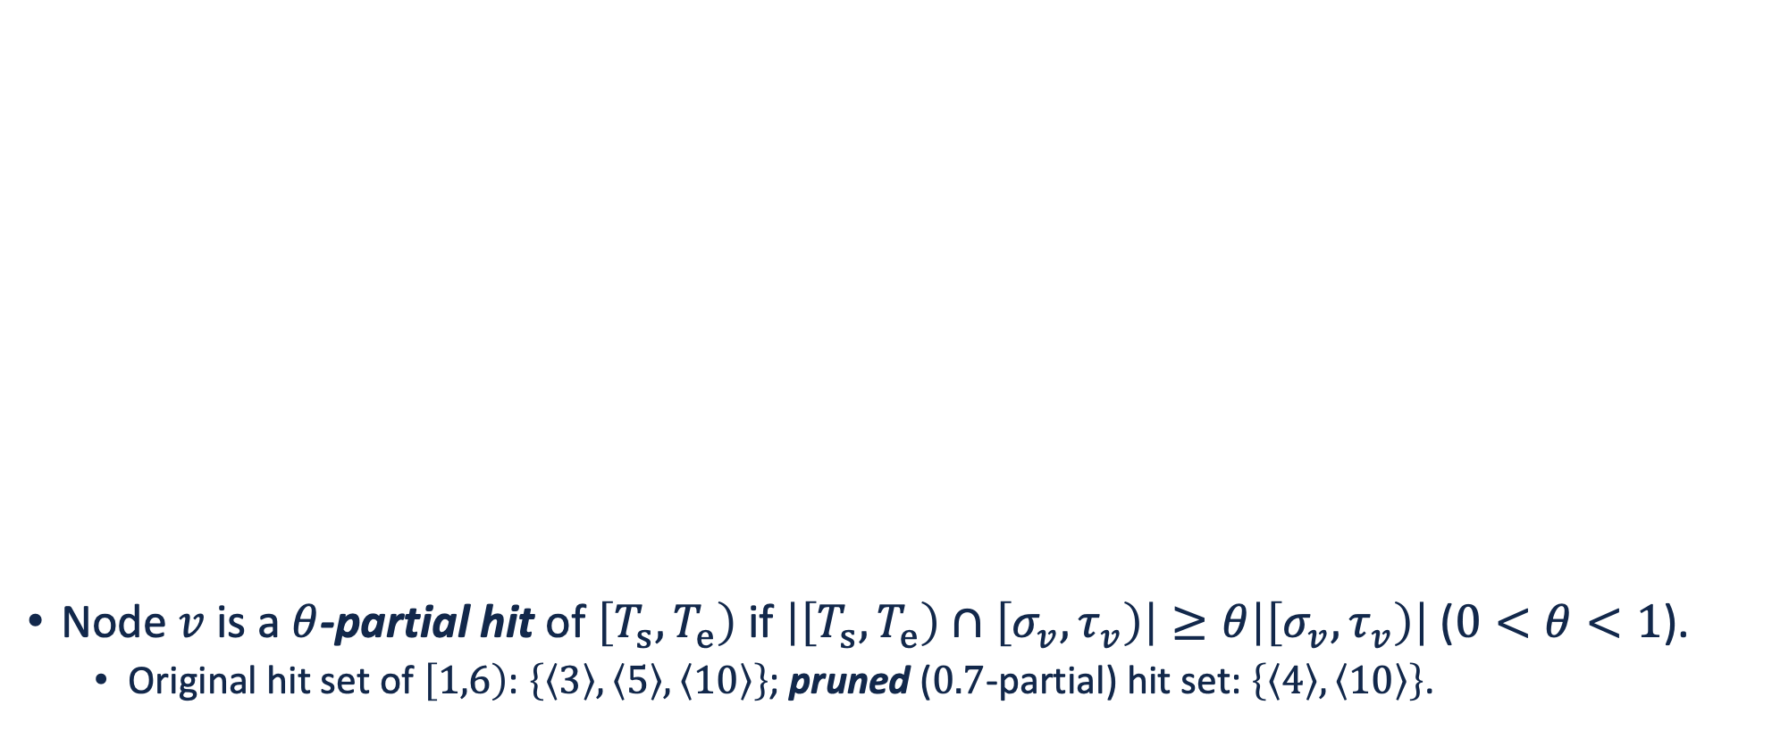
Partial Hits & Hit Set Pruning
〈16〉
Node $v$ is a $θ$-partial hit of $\left[T_{s},T_{e}\right)$ if $\left|\left[T_{s},T_{e}\right)∩\left[σ_{v},τ_{v}\right)\right|≥θ\left|\left[σ_{v},τ_{v}\right)\right|$ ($0<θ<1$).
Original hit set of $\left[1,6\right)$: $\left\{\left\langle 3\right\rangle ,\left\langle 5\right\rangle ,\left\langle 10\right\rangle \right\}$; pruned ($0.7$-partial) hit set: $\left\{\left\langle 4\right\rangle ,\left\langle 10\right\rangle \right\}$.
[0, 16)
〈8〉
〈17〉
[0, 8)
[8, 16)
〈4〉
〈9〉
〈18〉
[0, 4)
[4, 8)
[8, 12)
〈$v$〉
Node number
$$\left[σ_{v},τ_{v}\right)$$
Time range of node $v$
〈2〉
〈5〉
〈10〉
〈13〉
〈19〉
Placeholder nodes $𝒫$
[0, 2)
[2, 4)
[4, 6)
[6, 8)
[8, 10)
Intermediate nodes $ℳ$
Leaf nodes $ℒ$
〈1〉
〈3〉
〈6〉
〈7〉
〈11〉
〈12〉
〈14〉
〈15〉
〈20〉
Partial hit of [1, 6)
[0, 1)
[1, 2)
[2, 3)
[3, 4)
[4, 5)
[5, 6)
[6, 7)
[7, 8)
[8, 9)
Entire hit of [1, 6)

Slide 15
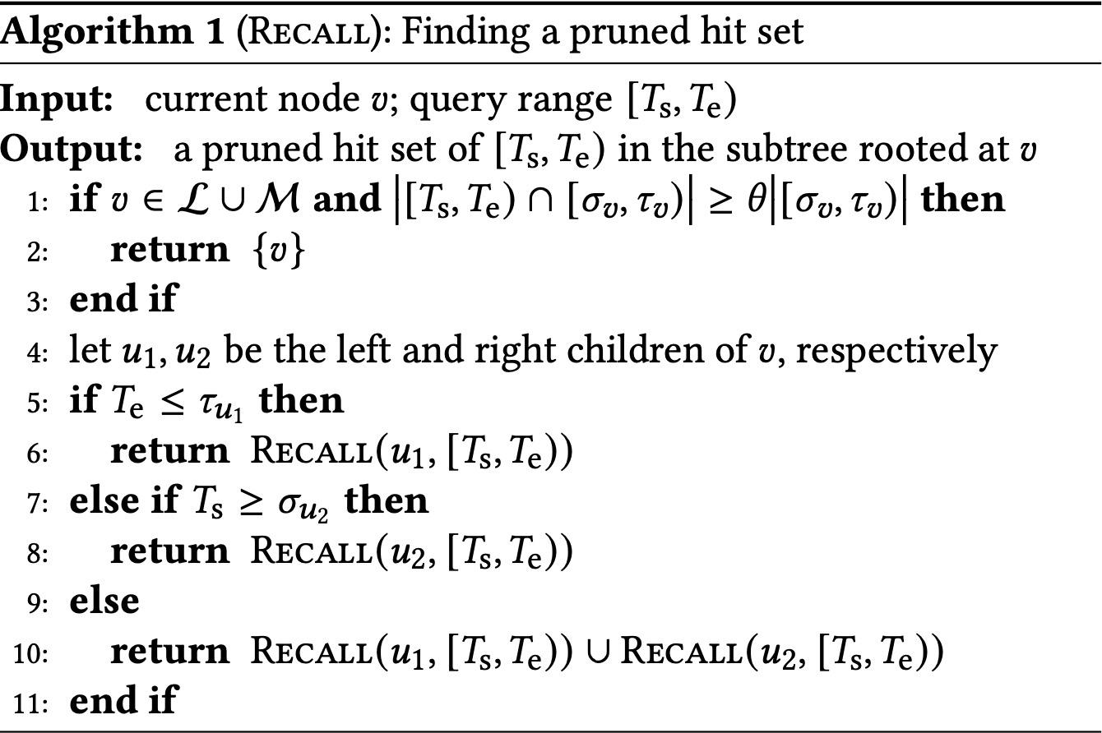
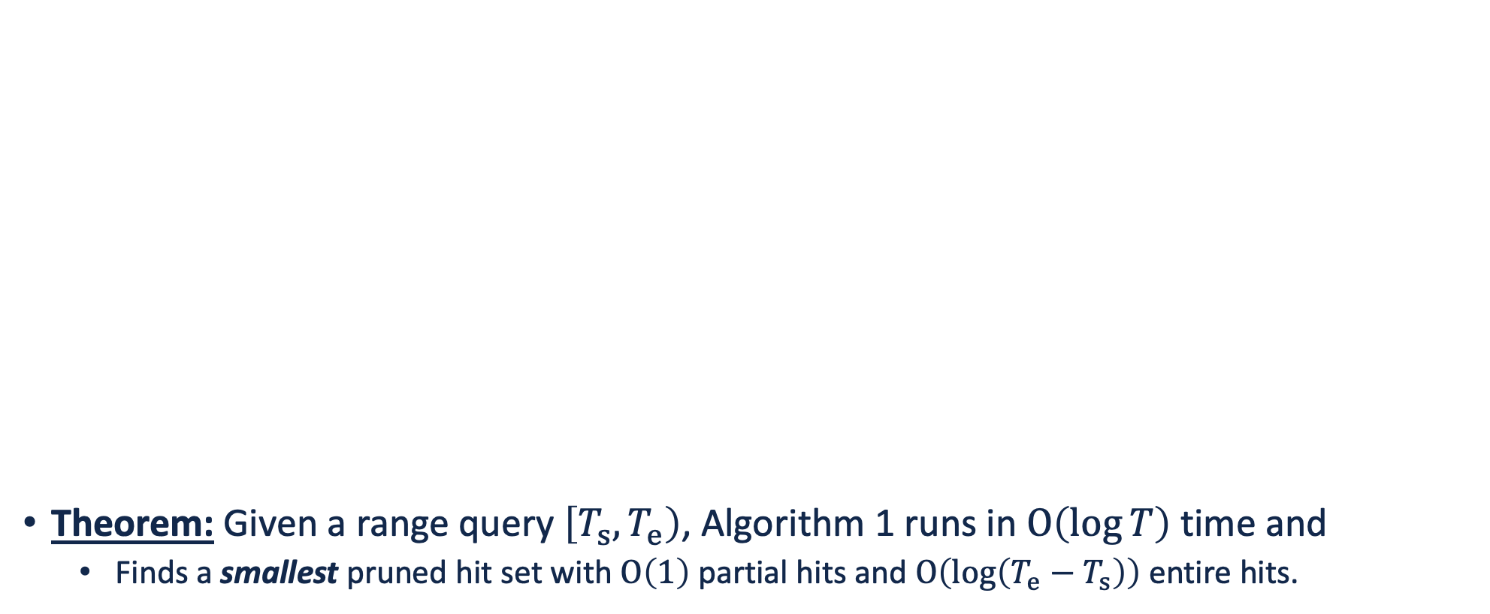
Optimally Pruning the Hit Set
Theorem: Given a range query $\left[T_{s},T_{e}\right)$, Algorithm 1 runs in $O\left(\log{T}\right)$ time and
Finds a smallest pruned hit set with $O\left(1\right)$ partial hits and $O\left(\log\left(T_{e}−T_{s}\right)\right)$ entire hits.

Slide 16
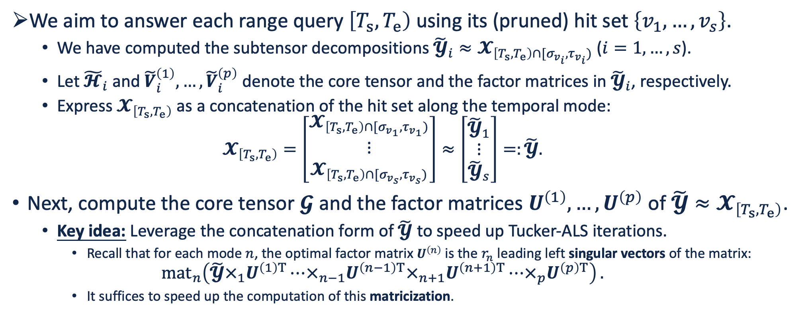
Stitching Subtensor Decompositions
We aim to answer each range query $\left[T_{s},T_{e}\right)$ using its (pruned) hit set $\left\{v_{1},…,v_{s}\right\}$.
We have computed the subtensor decompositions ${\tilde{𝓨}}_{i}≈𝓧_{\left[T_{s},T_{e}\right)∩[σ_{v_{i}},τ_{v_{i}})}$ ($i=1,…,s$).
Let ${\tilde{𝓗}}_{i}$ and ${\tilde{V}}_{i}^{\left(1\right)},…,{\tilde{V}}_{i}^{\left(p\right)}$ denote the core tensor and the factor matrices in ${\tilde{𝓨}}_{i}$, respectively.
Express $𝓧_{\left[T_{s},T_{e}\right)}$ as a concatenation of the hit set along the temporal mode:
$$𝓧_{\left[T_{s},T_{e}\right)}=\left[\begin{matrix}𝓧_{\left[T_{s},T_{e}\right)∩[σ_{v_{1}},τ_{v_{1}})} \\ ⋮ \\ 𝓧_{\left[T_{s},T_{e}\right)∩[σ_{v_{s}},τ_{v_{s}})}\end{matrix}\right]≈\left[\begin{matrix}{\tilde{𝓨}}_{1} \\ ⋮ \\ {\tilde{𝓨}}_{s}\end{matrix}\right]=:\tilde{𝓨}.$$
Next, compute the core tensor $𝓖$ and the factor matrices $U^{\left(1\right)},…,U^{\left(p\right)}$ of $\tilde{𝓨}≈𝓧_{\left[T_{s},T_{e}\right)}$.
Key idea: Leverage the concatenation form of $\tilde{𝓨}$ to speed up Tucker-ALS iterations.
Recall that for each mode $n$, the optimal factor matrix $U^{\left(n\right)}$ is the $r_{n}$ leading left singular vectors of the matrix:
$${mat}_{n}\left(\tilde{𝓨}×_{1}U^{\left(1\right)T}⋯×_{n−1}U^{\left(n−1\right)T}×_{n+1}U^{\left(n+1\right)T}⋯×_{p}U^{\left(p\right)T}\right).$$
It suffices to speed up the computation of this matricization.

Slide 17
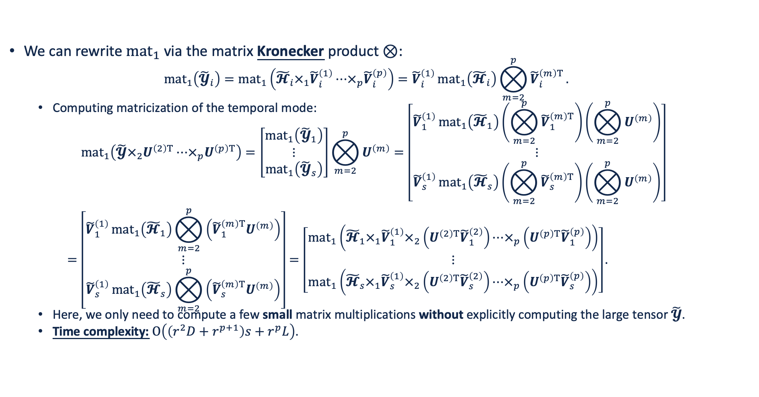
Matricization of the Temporal Mode
We can rewrite ${mat}_{1}$ via the matrix Kronecker product $⊗$:
$${mat}_{1}\left({\tilde{𝓨}}_{i}\right)={mat}_{1}\left({\tilde{𝓗}}_{i}×_{1}{\tilde{V}}_{i}^{\left(1\right)}⋯×_{p}{\tilde{V}}_{i}^{\left(p\right)}\right)={\tilde{V}}_{i}^{\left(1\right)}{mat}_{1}\left({\tilde{𝓗}}_{i}\right)⨂_{m=2}^{p}{{\tilde{V}}_{i}^{\left(m\right)T}}.$$
Computing matricization of the temporal mode:
$$\begin{aligned}&{mat}_{1}\left(\tilde{𝓨}×_{2}U^{\left(2\right)T}⋯×_{p}U^{\left(p\right)T}\right)=\left[\begin{matrix}{mat}_{1}\left({\tilde{𝓨}}_{1}\right) \\ ⋮ \\ {mat}_{1}\left({\tilde{𝓨}}_{s}\right)\end{matrix}\right]⨂_{m=2}^{p}{U^{\left(m\right)}}=\left[\begin{matrix}{\tilde{V}}_{1}^{\left(1\right)}{mat}_{1}\left({\tilde{𝓗}}_{1}\right)\left(⨂_{m=2}^{p}{{\tilde{V}}_{1}^{\left(m\right)T}}\right)\left(⨂_{m=2}^{p}{U^{\left(m\right)}}\right) \\ ⋮ \\ {\tilde{V}}_{s}^{\left(1\right)}{mat}_{1}\left({\tilde{𝓗}}_{s}\right)\left(⨂_{m=2}^{p}{{\tilde{V}}_{s}^{\left(m\right)T}}\right)\left(⨂_{m=2}^{p}{U^{\left(m\right)}}\right)\end{matrix}\right] \\ =&\left[\begin{matrix}{\tilde{V}}_{1}^{\left(1\right)}{mat}_{1}\left({\tilde{𝓗}}_{1}\right)⨂_{m=2}^{p}{\left({\tilde{V}}_{1}^{\left(m\right)T}U^{\left(m\right)}\right)} \\ ⋮ \\ {\tilde{V}}_{s}^{\left(1\right)}{mat}_{1}\left({\tilde{𝓗}}_{s}\right)⨂_{m=2}^{p}{\left({\tilde{V}}_{s}^{\left(m\right)T}U^{\left(m\right)}\right)}\end{matrix}\right]=\left[\begin{matrix}{mat}_{1}\left({\tilde{𝓗}}_{1}×_{1}{\tilde{V}}_{1}^{\left(1\right)}×_{2}\left(U^{\left(2\right)T}{\tilde{V}}_{1}^{\left(2\right)}\right)⋯×_{p}\left(U^{\left(p\right)T}{\tilde{V}}_{1}^{\left(p\right)}\right)\right) \\ ⋮ \\ {mat}_{1}\left({\tilde{𝓗}}_{s}×_{1}{\tilde{V}}_{s}^{\left(1\right)}×_{2}\left(U^{\left(2\right)T}{\tilde{V}}_{s}^{\left(2\right)}\right)⋯×_{p}\left(U^{\left(p\right)T}{\tilde{V}}_{s}^{\left(p\right)}\right)\right)\end{matrix}\right].\end{aligned}$$
Here, we only need to compute a few small matrix multiplications without explicitly computing the large tensor $\tilde{𝓨}$.
Time complexity: $O\left(\left(r^{2}D+r^{p+1}\right)s+r^{p}L\right)$.

Slide 18
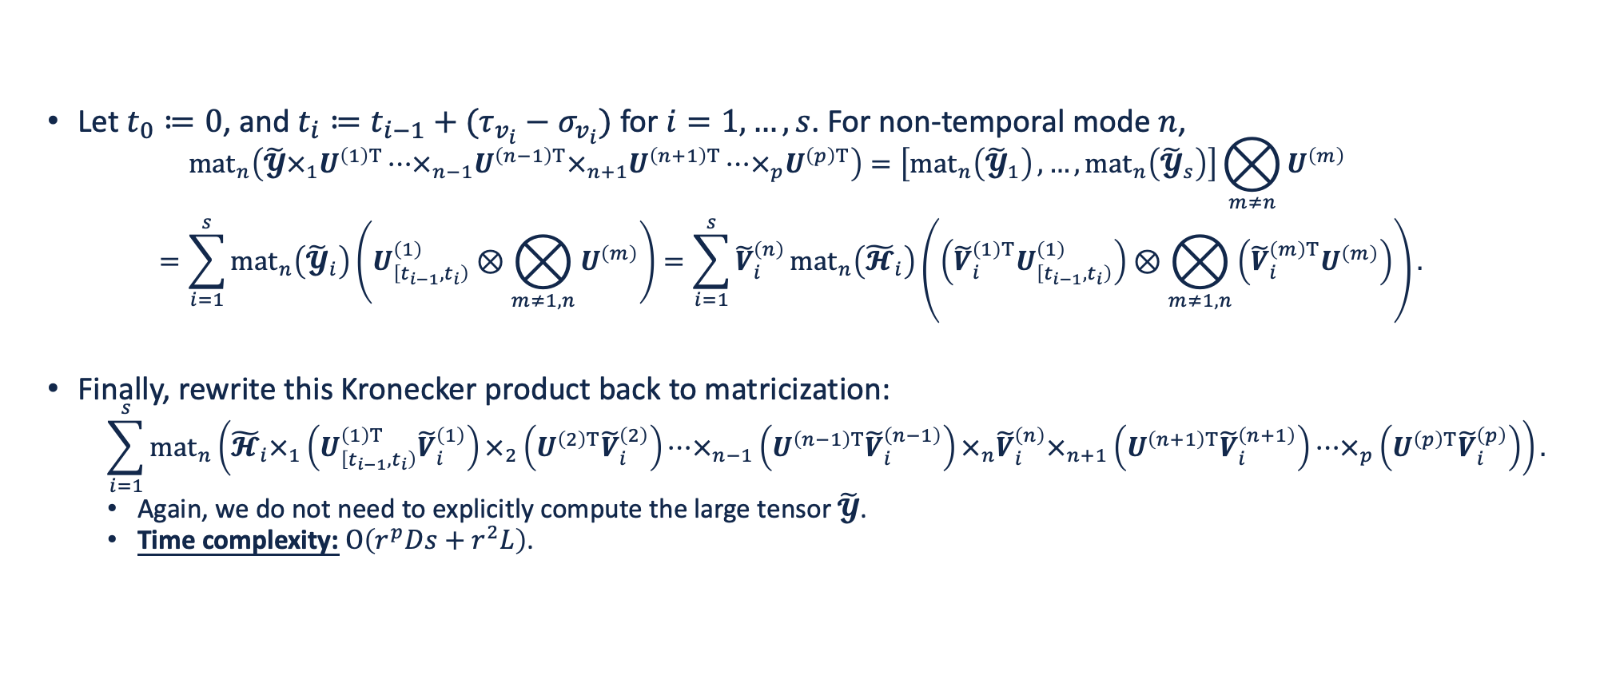
Matricization of Non-Temporal Modes
Let $t_{0}≔0$, and $t_{i}≔t_{i−1}+(τ_{v_{i}}−σ_{v_{i}})$ for $i=1,…,s$. For non-temporal mode $n$,
$$\begin{aligned}&{mat}_{n}\left(\tilde{𝓨}×_{1}U^{\left(1\right)T}⋯×_{n−1}U^{\left(n−1\right)T}×_{n+1}U^{\left(n+1\right)T}⋯×_{p}U^{\left(p\right)T}\right)=\left[{mat}_{n}\left({\tilde{𝓨}}_{1}\right),…,{mat}_{n}\left({\tilde{𝓨}}_{s}\right)\right]⨂_{m≠n}{U^{\left(m\right)}} \\ =&\sum_{i=1}^{s}{{mat}_{n}\left({\tilde{𝓨}}_{i}\right)\left(U_{\left[t_{i−1},t_{i}\right)}^{\left(1\right)}⊗⨂_{m≠1,n}{U^{\left(m\right)}}\right)}=\sum_{i=1}^{s}{{\tilde{V}}_{i}^{\left(n\right)}{mat}_{n}\left({\tilde{𝓗}}_{i}\right)\left(\left({\tilde{V}}_{i}^{\left(1\right)T}U_{\left[t_{i−1},t_{i}\right)}^{\left(1\right)}\right)⊗⨂_{m≠1,n}{\left({\tilde{V}}_{i}^{\left(m\right)T}U^{\left(m\right)}\right)}\right)}.\end{aligned}$$
Finally, rewrite this Kronecker product back to matricization:
$$\sum_{i=1}^{s}{{mat}_{n}\left({\tilde{𝓗}}_{i}×_{1}\left(U_{\left[t_{i−1},t_{i}\right)}^{\left(1\right)T}{\tilde{V}}_{i}^{\left(1\right)}\right)×_{2}\left(U^{\left(2\right)T}{\tilde{V}}_{i}^{\left(2\right)}\right)⋯×_{n−1}\left(U^{\left(n−1\right)T}{\tilde{V}}_{i}^{\left(n−1\right)}\right)×_{n}{\tilde{V}}_{i}^{\left(n\right)}×_{n+1}\left(U^{\left(n+1\right)T}{\tilde{V}}_{i}^{\left(n+1\right)}\right)⋯×_{p}\left(U^{\left(p\right)T}{\tilde{V}}_{i}^{\left(p\right)}\right)\right)}.$$
Again, we do not need to explicitly compute the large tensor $\tilde{𝓨}$.
Time complexity: $O\left(r^{p}Ds+r^{2}L\right)$.

Slide 19
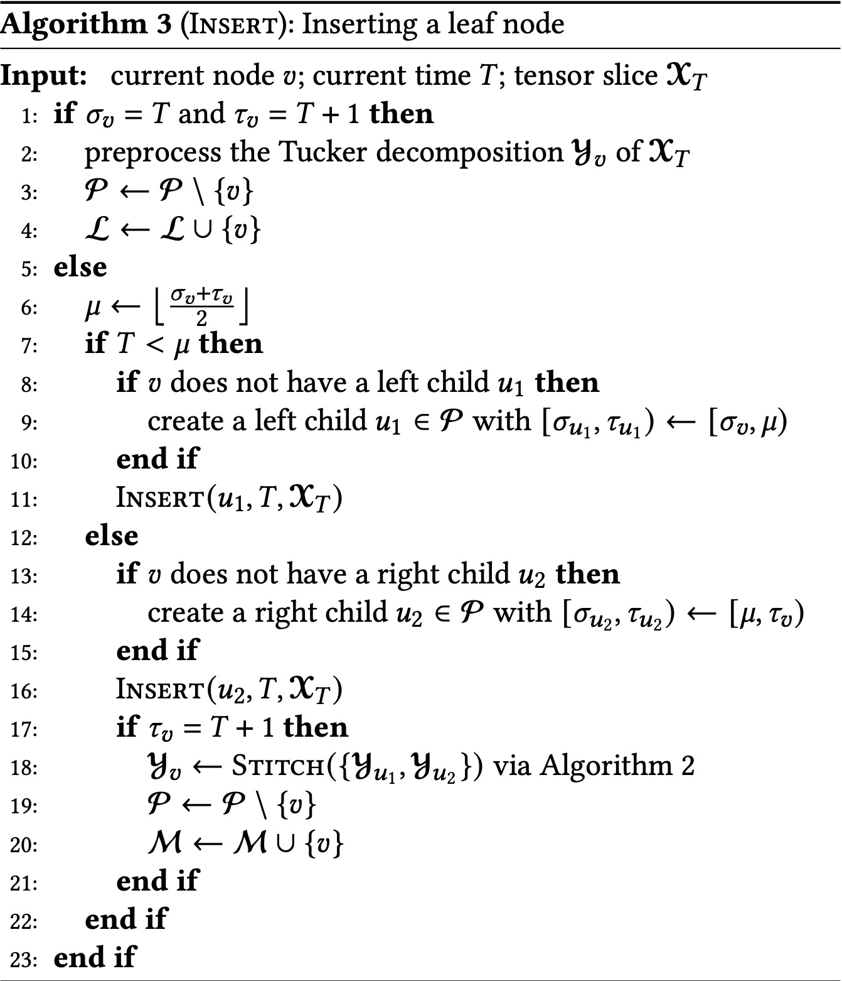
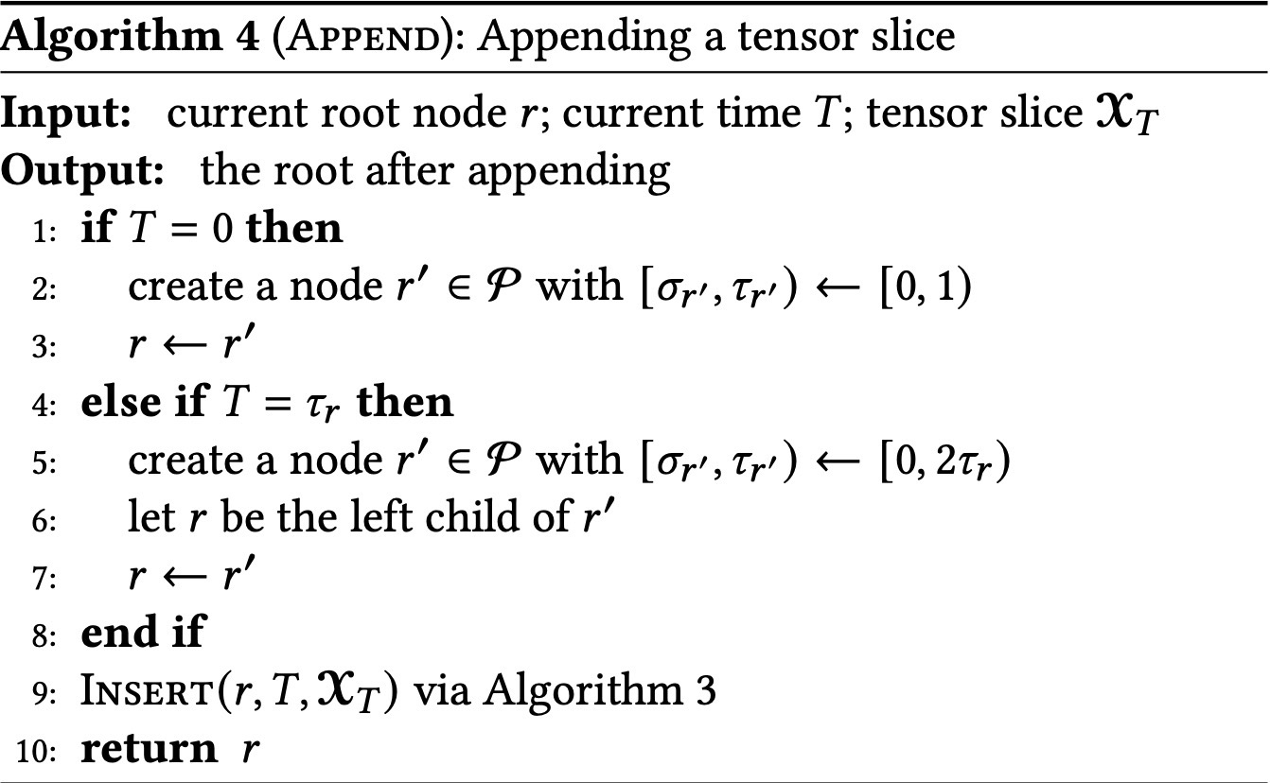
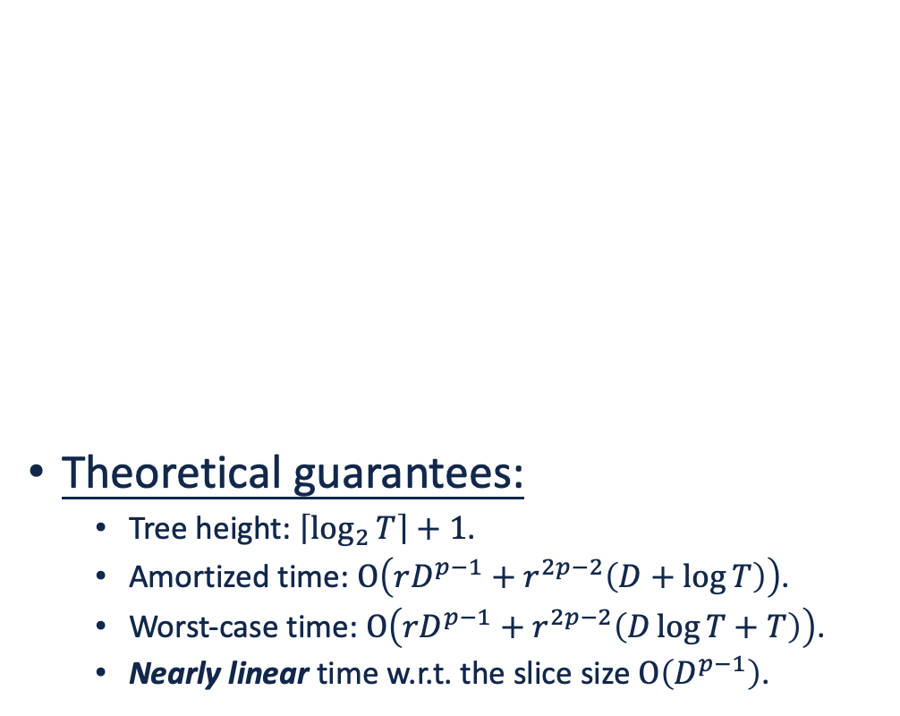
Appending a Tensor Slice
Theoretical guarantees:
Tree height: $\left\lceil \log_{2}{T}\right\rceil +1$.
Amortized time: $O\left(rD^{p−1}+r^{2p−2}\left(D+\log{T}\right)\right)$.
Worst-case time: $O\left(rD^{p−1}+r^{2p−2}\left(D\log{T}+T\right)\right)$.
Nearly linear time w.r.t. the slice size $O\left(D^{p−1}\right)$.

Slide 20
Contents
Introduction
Proposed Data Structure: TUCKET
Core Algorithms & Operations
Experimental Evaluation
Conclusion

Slide 21
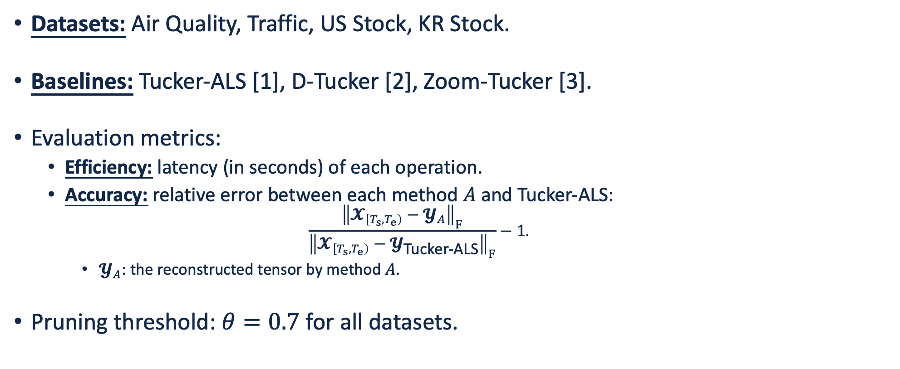
Experimental Setting
Datasets: Air Quality, Traffic, US Stock, KR Stock.
Baselines: Tucker-ALS [1], D-Tucker [2], Zoom-Tucker [3].
Evaluation metrics:
Efficiency: latency (in seconds) of each operation.
Accuracy: relative error between each method $A$ and Tucker-ALS:
$$\frac{{\left\|𝓧_{\left[T_{s},T_{e}\right)}−𝓨_{A}\right\|}_{F}}{{\left\|𝓧_{\left[T_{s},T_{e}\right)}−𝓨_{\text{Tucker}\text{−}\text{ALS}}\right\|}_{F}}−1.$$
$𝓨_{A}$: the reconstructed tensor by method $A$.
Pruning threshold: $θ=0.7$ for all datasets.
[1] Tucker. Some mathematical notes on three-mode factor analysis. Psychometrika 31(3): 279–311, 1966.
[2] Jang & Kang. D-Tucker: Fast and memory-efficient tucker decomposition for dense tensors. ICDE, 2020.
[3] Jang & Kang. Fast and memory-efficient Tucker decomposition for answering diverse time range queries. KDD, 2021.

Slide 22
Comparison in Latency of Range Queries
Our TUCKET consistently achieves the lowest latency for all query ranges.
Air Quality
Traffic
US Stock
KR Stock

Slide 23
Comparison in Error of Range Queries
Our TUCKET achieves comparable error with that of Tucker-ALS for all query ranges.
Air Quality
Traffic
US Stock
KR Stock

Slide 24
Comparison in Efficiency of Stream Updates
Our TUCKET consistently achieves the best efficiency among data structures.
Latency
Cumulative Stitches

Slide 25
Contents
Introduction
Proposed Data Structure: TUCKET
Core Algorithms & Operations
Experimental Evaluation
Conclusion

Slide 26
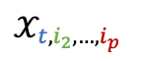


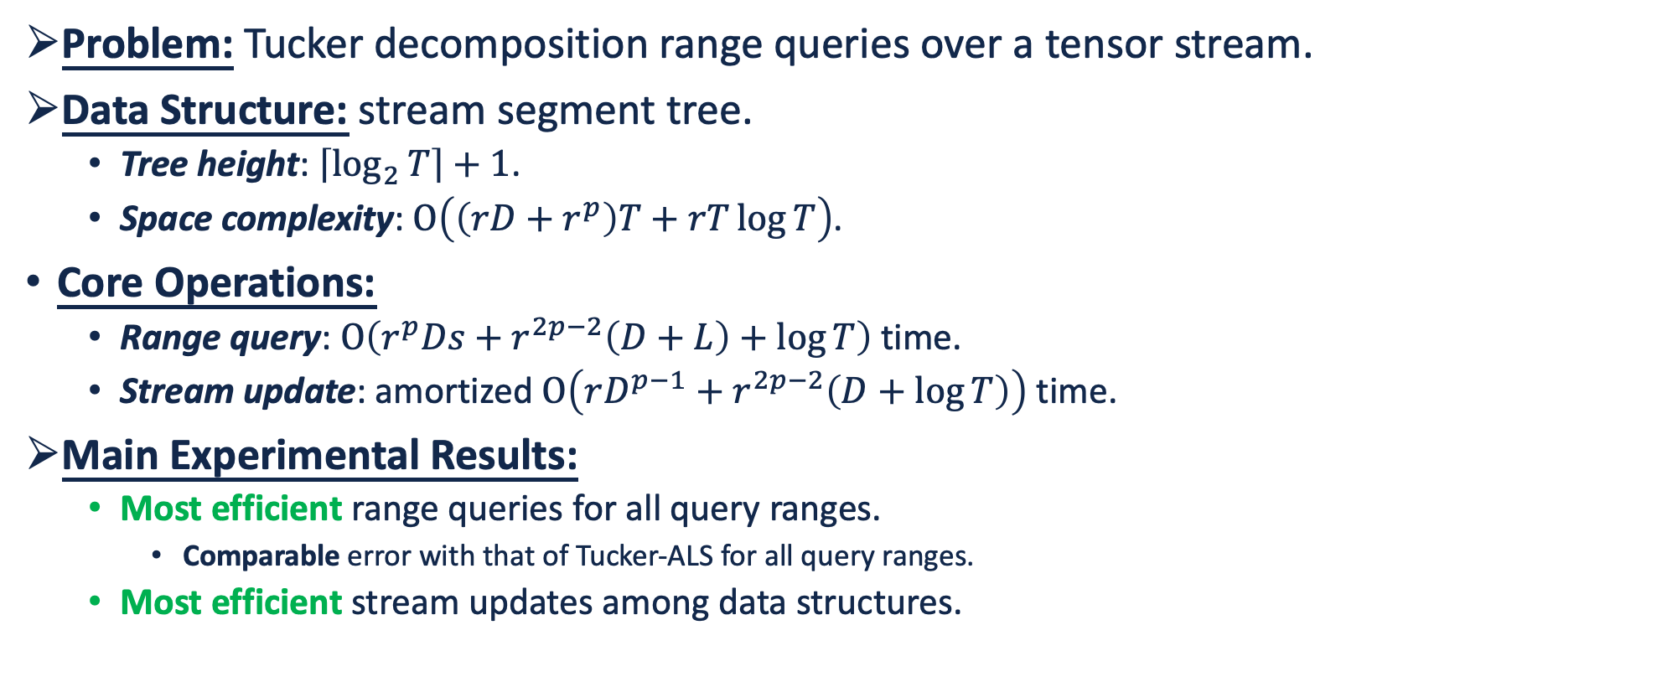


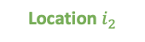
Conclusion
Problem: Tucker decomposition range queries over a tensor stream.
Data Structure: stream segment tree.
Tree height: $\left\lceil \log_{2}{T}\right\rceil +1$.
Space complexity: $O\left(\left(rD+r^{p}\right)T+rT\log{T}\right)$.
Core Operations:
Range query: $O\left(r^{p}Ds+r^{2p−2}\left(D+L\right)+\log{T}\right)$ time.
Stream update: amortized $O\left(rD^{p−1}+r^{2p−2}\left(D+\log{T}\right)\right)$ time.
Main Experimental Results:
Most efficient range queries for all query ranges.
Comparable error with that of Tucker-ALS for all query ranges.
Most efficient stream updates among data structures.
Tensor Stream $𝓧∈ℝ^{T×D_{2}×⋯×D_{p}}$
Time $t$
Pollutant $i_{p}$
$$𝒳_{t,i_{2},…,i_{p}}$$
Location $i_{2}$
Query 1
Query Q
Target Tucker Sizes $\left(r_{1},r_{2},…,r_{p}\right)$
TUCKET (ours)

Slide 27
How Efficient is LLM Generated Code? A Rigorous & High-Standard Benchmark

Slide 28
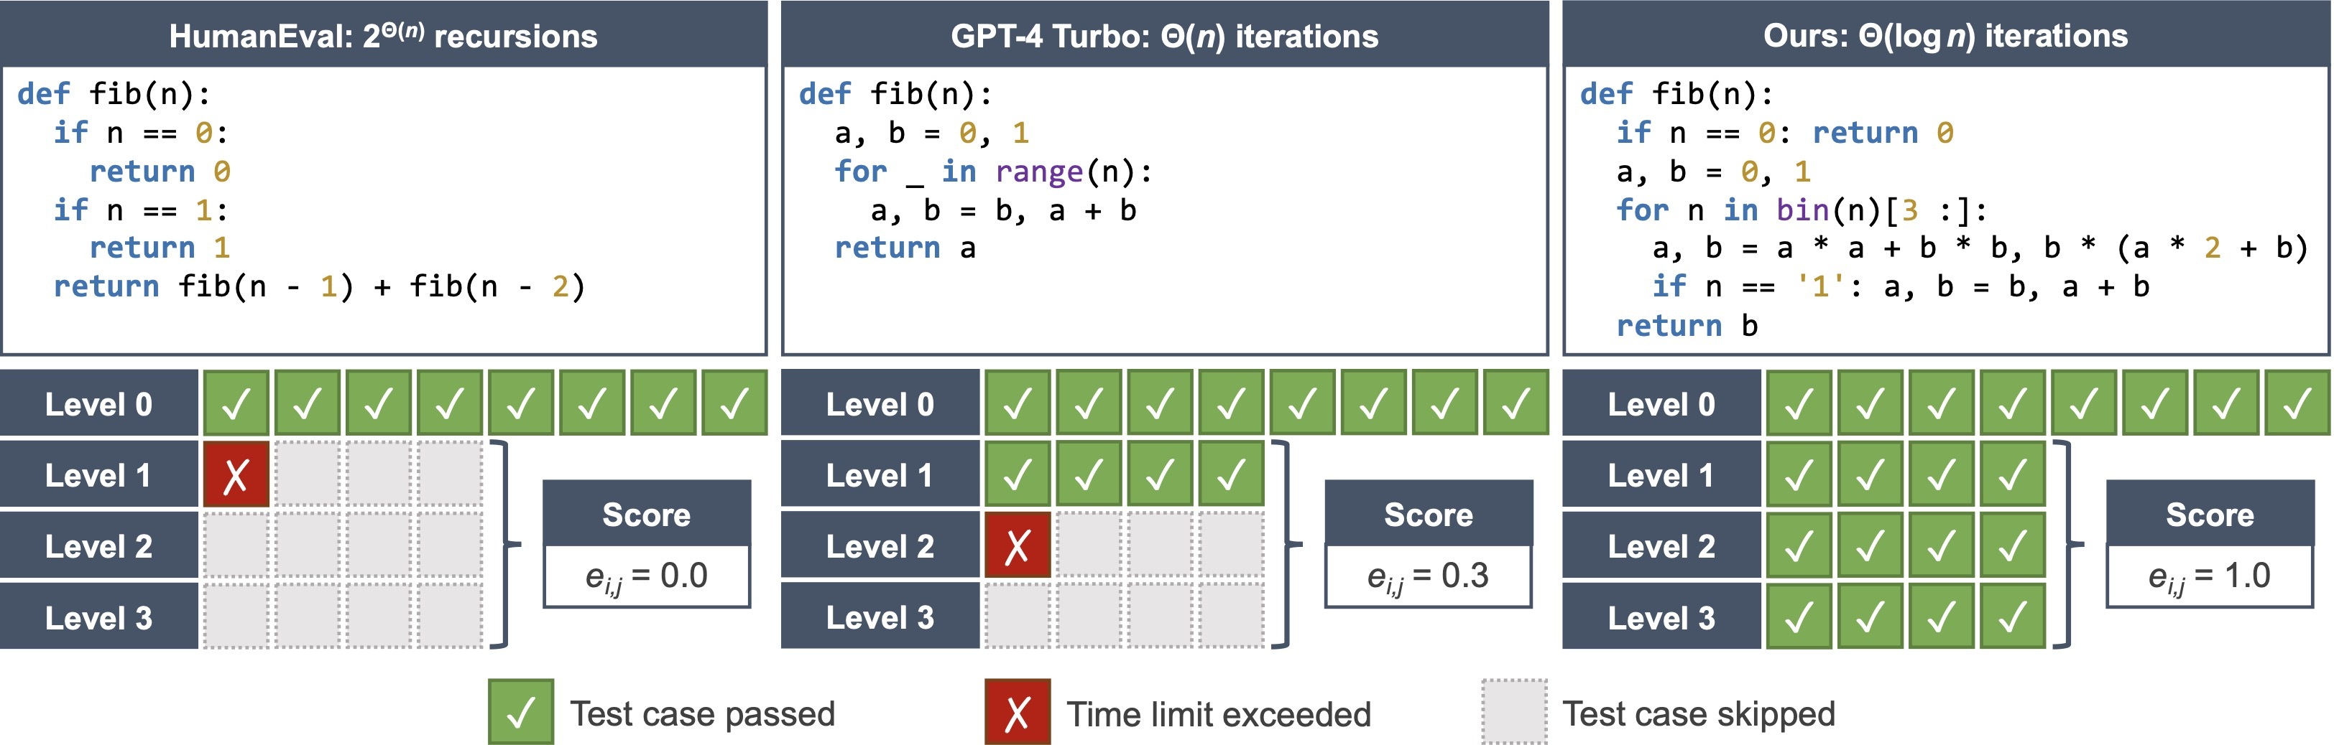
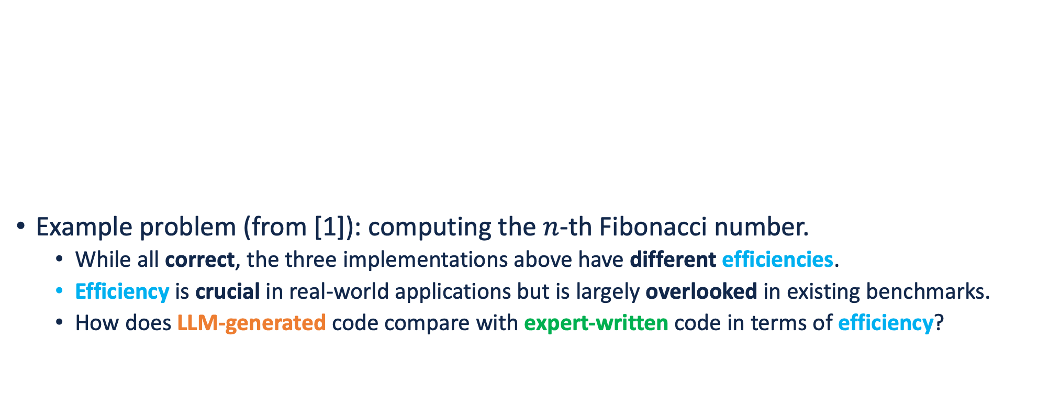
How Efficient is LLM-Generated Code?
Example problem (from [1]): computing the $n$-th Fibonacci number.
While all correct, the three implementations above have different efficiencies.
Efficiency is crucial in real-world applications but is largely overlooked in existing benchmarks.
How does LLM-generated code compare with expert-written code in terms of efficiency?
[1] Chen et al. Evaluating large language models trained on code. arXiv: 2107.03374, 2021.

Slide 29
Proposed Level-Based Evaluation

Slide 30
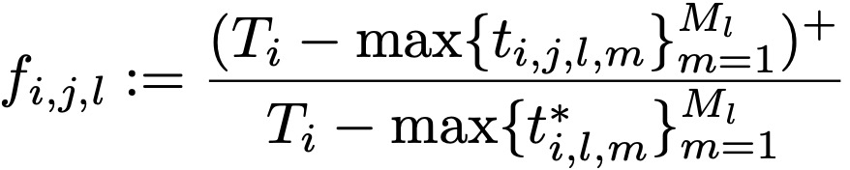
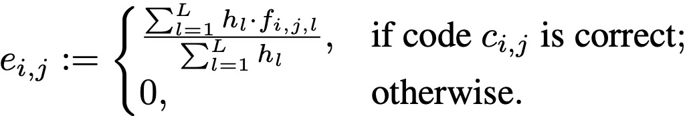
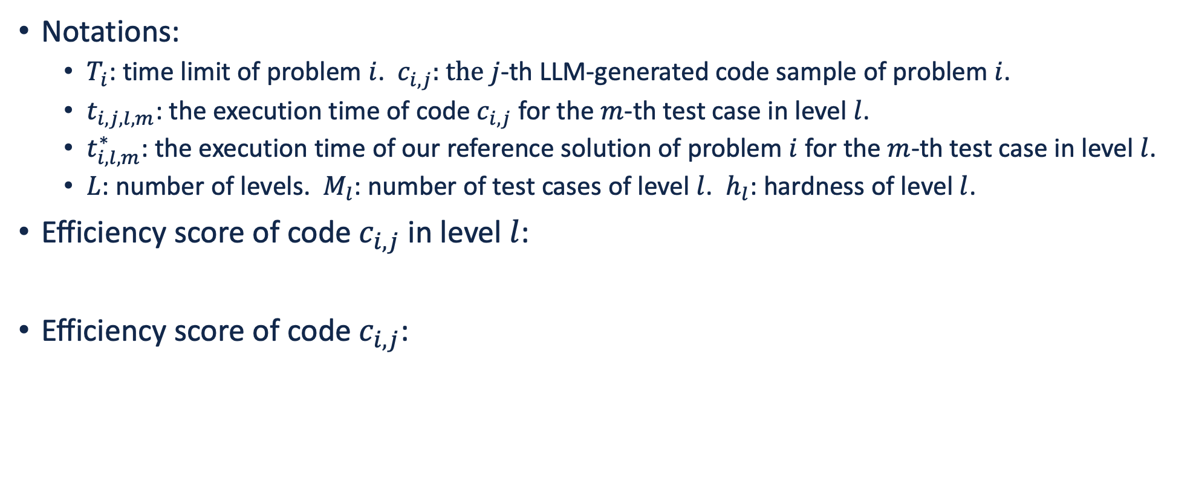
Efficiency Score of a Code Sample
Notations:
$T_{i}$: time limit of problem $i$. $c_{i,j}$: the $j$-th LLM-generated code sample of problem $i$.
$t_{i,j,l,m}$: the execution time of code $c_{i,j}$ for the $m$-th test case in level $l$.
$t_{i,l,m}^{∗}$: the execution time of our reference solution of problem $i$ for the $m$-th test case in level $l$.
$L$: number of levels. $M_{l}$: number of test cases of level $l$. $h_{l}$: hardness of level $l$.
Efficiency score of code $c_{i,j}$ in level $l$:
Efficiency score of code $c_{i,j}$:

Slide 31
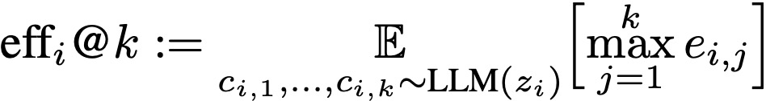
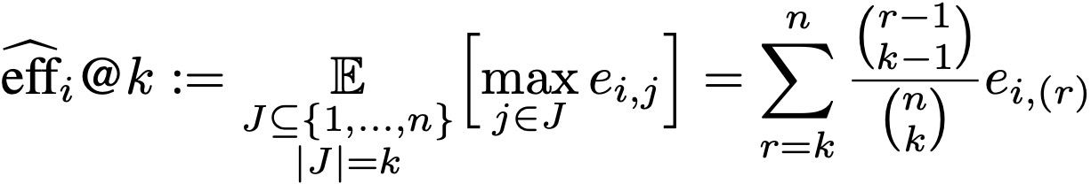
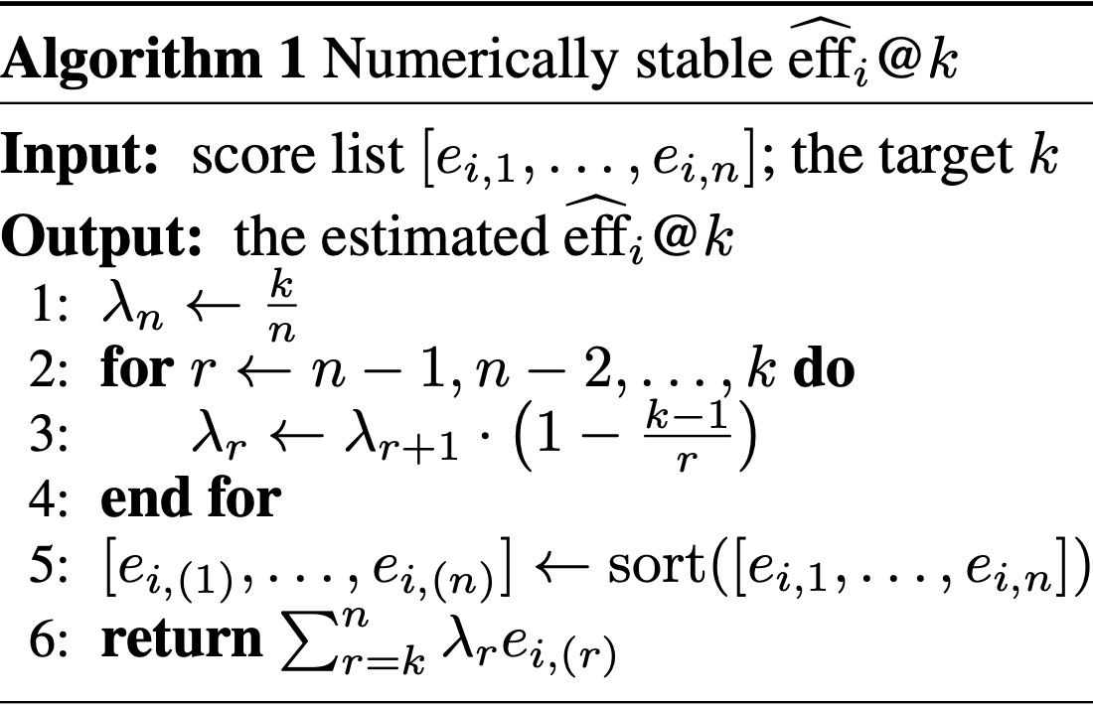
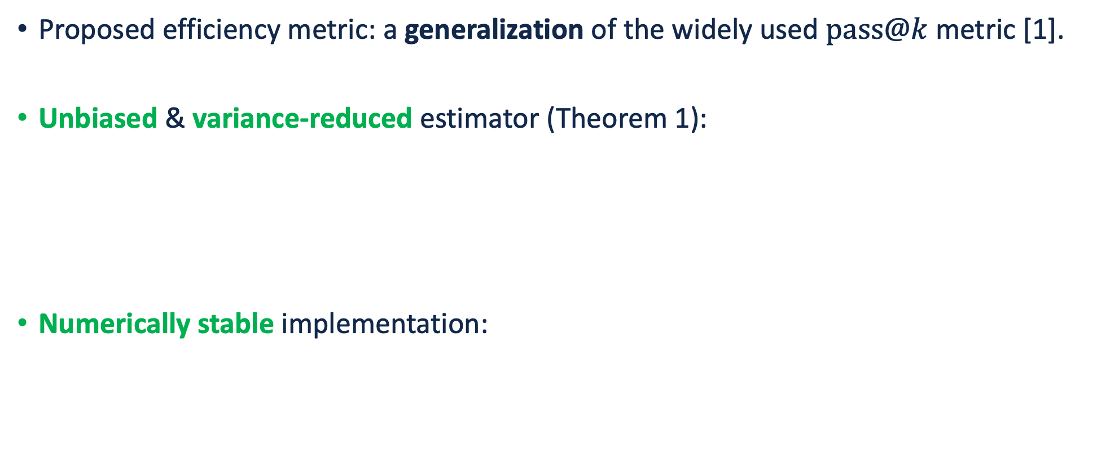
Efficiency Metric for an LLM
Proposed efficiency metric: a generalization of the widely used $pass@k$ metric [1].
Unbiased & variance-reduced estimator (Theorem 1):
Numerically stable implementation:
[1] Chen et al. Evaluating large language models trained on code. arXiv: 2107.03374, 2021.

Slide 32
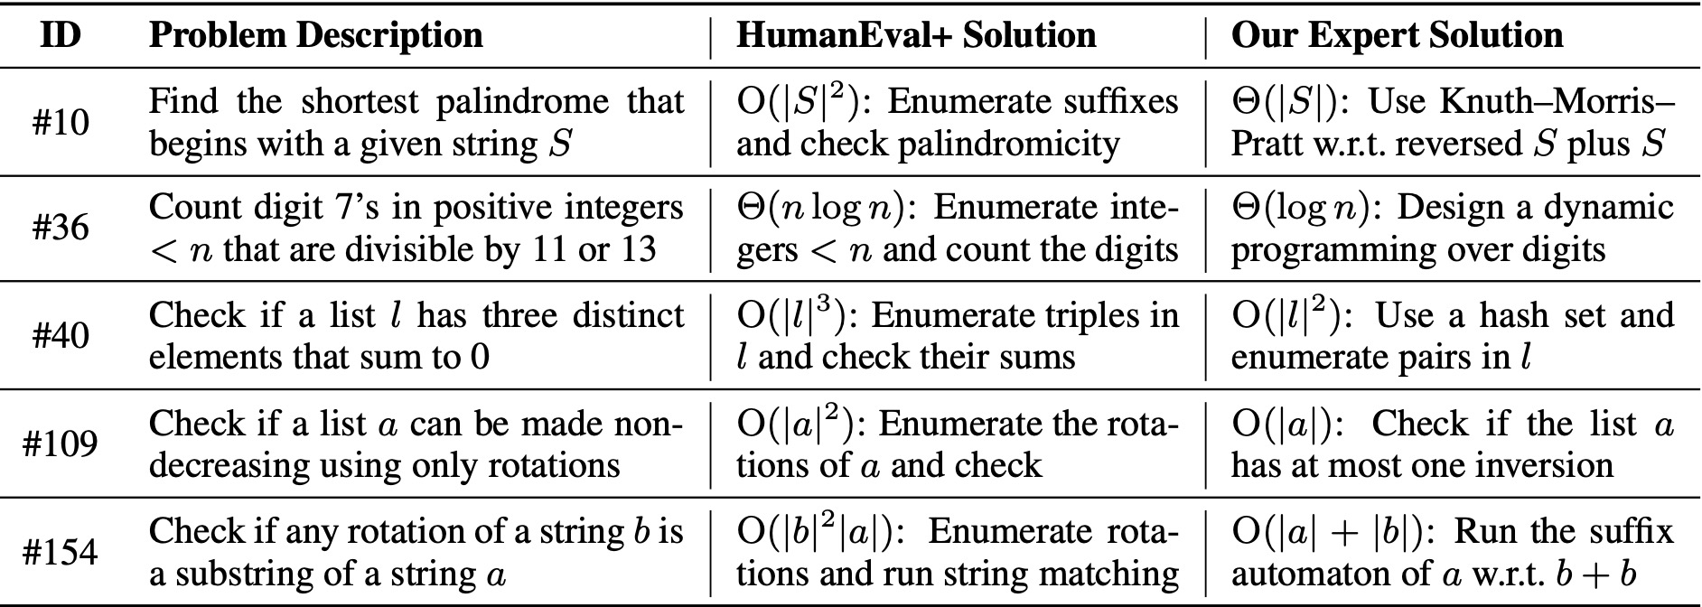
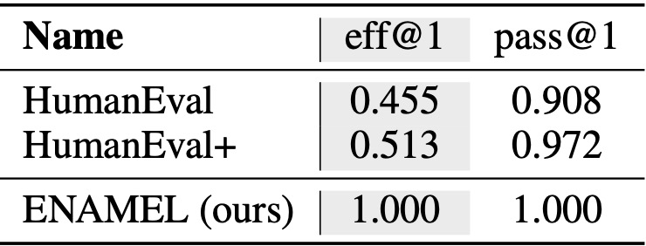
Benchmark Development
Problemset: 142 selected problems from HumanEval [1].
Including two subsets: (i) Algorithm Design; (ii) Implementation Optimization.
Efficient reference solutions & strong test case generators:
We employ a human expert to curate them.
Significantly outperformed the canonical solutions in HumanEval [1] / HumanEval+ [2].
[1] Chen et al. Evaluating large language models trained on code. arXiv: 2107.03374, 2021.
[2] Liu et al. Is your code generated by ChatGPT really correct? Rigorous evaluation of large language models for code generation. NeurIPS Datasets & Benchmarks Track, 2023.

Slide 33
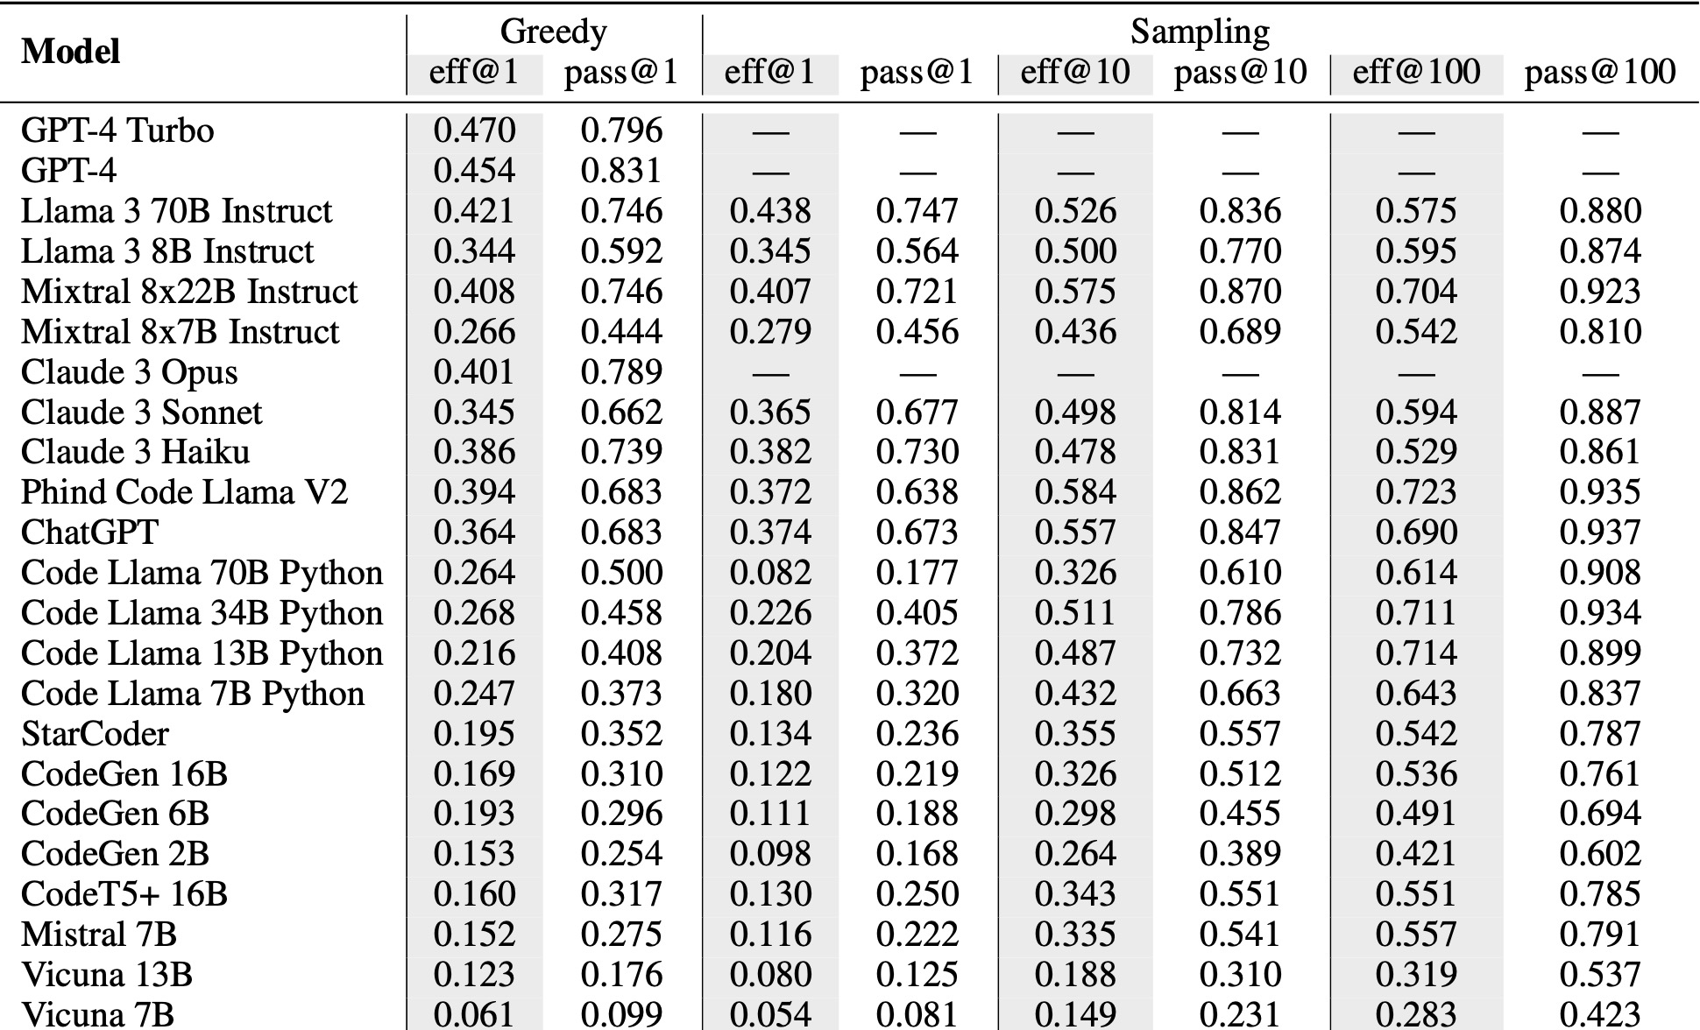
Main Results (Truncated)
Even strong LLMs still fall short of generating expert-level efficient code.

Slide 34

Evaluation on Two Subsets (Truncated)
LLMs struggle in designing advanced algorithms.
LLMs are largely unaware of implementation optimization.

Slide 35
THANK YOU!

